Slide 1
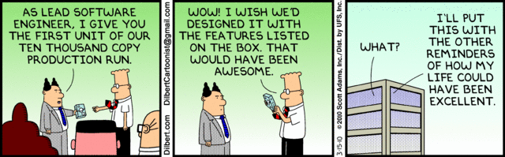
Software Engineering
Lecture 3 – Designing, Understanding and Visualizing Software Architecture
Slides inspired by Richard Taylor, University of California

Slide 2
WAT
https://www.destroyallsoftware.com/talks/wat
https://www.destroyallsoftware.com/talks/useing-youre-types-good

Slide 3
Last time
The context of Architecture
How it fits into the Software Development Lifecycle

Slide 4
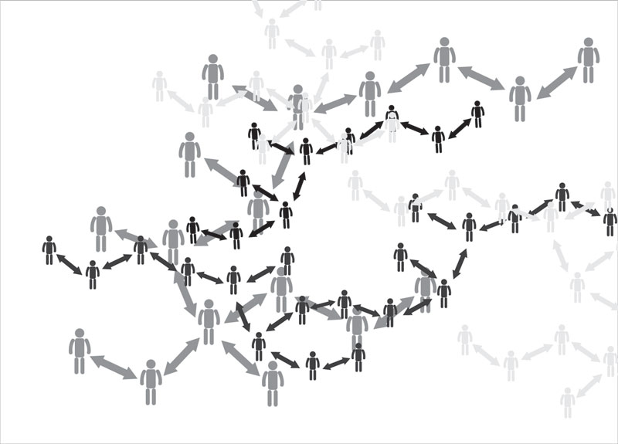
Recap: Russian Post Communication?

Slide 5

Recap: Code-rot
Minimize size and complexity of the code
Eliminate unnecessary dependencies
High cohesion, weak coupling
Strive to eliminate communication bottlenecks
Constant evaluation – continuous improvements
Notes:
How do you prevent code-rot? You minimize the size and complexity of the code components, the way you would with teams. You eliminate unnecessary dependencies in favor of cohesive units. You make sure you have solid backup plans around any high-risk communication bottlenecks and you try to eliminate those whenever possible. And you evaluate the whole thing on a consistent basis to ensure that you’re getting better (or at least not getting worse).

Slide 6
Software Architecture Design
Often idealistic
Various degrees of simplification
May focus on different software qualities
May be directed towards different stakeholders
Different views for different people

Slide 7
Stakeholders
Architect
Requirements engineer
Designer (also of other systems)
Implementor
Tester, integrator
Maintainer
Manager
Quality assurance people
Notes:
Architect: negotiates, makes tade-offs
Reqs engineer: idem
Designer: resolve issues, bv rond resource consumption, performance issues
Implementor: constraints and freedoms richting downstream activities.
Tester, integrator: correct black-box behavior of parts.
Maintainer: areas a prospective change will affect.
Manager: maken development team, assign tasks, plan resources, track progress.
QA: basis for conformance checking

Slide 8
Visualising architecture

Slide 9
Some terms (from IEEE standard)
System stakeholder: an individual, team, or organization with interests in a system.
View: a representation from the perspective of a related set of concerns.
Viewpoint: purposes and audience for a view.

Slide 10
Viewpoint specification
Viewpoint name
Stakeholders addressed
Concerns addressed
Language, modeling techniques

Slide 11
Kruchten’s 4+1 view model

Slide 12
4 + 1: Logical Viewpoint
functional requirements
the services the system should provide to its end users.
key abstractions
classes and interactions amongst them.
Class diagram, activity diagram, state diagram, etc.
Notes:
The logical view primarily supports the functional requirements; the services the system should provide to its end users.It depicts the major design elements and their interaction.
Designers decompose the system into a set of key abstractions, taken mainly from the problem domain. These abstractions are objects or object classes that exploit the principles of abstraction, encapsulation, and inheritance. In addition to aiding functional analysis, decomposition identifies mechanisms and design elements that are common across the system.
Components are related by “shares data with”

Slide 13
4 + 1: Process Viewpoint
concurrent aspects at runtime
tasks, threads, processes and their interactions
nonfunctional requirements
performance, system availability, concurrency and distribution, system integrity, and fault-tolerance.
Activity diagram, sequence diagram, etc.
Notes:
The process view takes into account some nonfunctional requirements, such as performance and system availability. It addresses concurrency and distribution, system integrity, and fault-tolerance. The process view also specifies which thread of control executes each operation of each class identified in the logical view.
So the process view describes the mapping of functions to runtime elements. It concenrs the dynamics of the system. A process is a group of tasks which form a logical unit. A process can be started, stopped, resumed, etc., and there is communication between processes.
Components are related by “synchronizes with”

Slide 14
4 + 1: Deployment Viewpoint
Also Physical viewpoint
Like a module diagram mapped on Device node and Execution environment node
How the various elements must be mapped onto the various nodes.
the system's nonfunctional requirements
system availability, reliability (fault-tolerance), performance (throughput), and scalability.
Notes:
The physical view takes into account the system's nonfunctional requirements such as system availability, reliability (fault-tolerance), performance (throughput), and scalability. The software executes on a network of computers (the processing nodes). The various elements identified in the logical, process, and development views-networks, processes, tasks, and objects-must be mapped onto the various nodes. Several different physical configurations will be used-some for development and testing, others for system deployment at various sites or for different customers. The mapping of the software to the nodes must therefore be highly flexible and have a minimal impact on the source code itself.
Components are related by “communicates with”

Slide 15
4 + 1: Implementation Viewpoint
organization of the actual software modules in the software-development environment.
small chunks-program libraries or subsystems
can be developed by one or more developers.
Component diagram, package diagram, etc.
Notes:
The development view focuses on the organization of the actual software modules in the software-development environment. The software is packaged in small chunks-program libraries or subsystems-that can be developed by one or more developers. The subsystems are organized in a hierarchy of layers, each layer providing a narrow and well-defined interface to the layers above it.
Components are related by “is submodule of”.

Slide 16
4 + 1: Scenario Viewpoint
small subset of important scenarios (e.g., use cases)
shows that the elements of the four viewpoints work together seamlessly.
redundant with the other ones (→ the "+1")
helps designers discover architectural elements
validates and illustrates the architecture design
on paper
as the starting point for the tests
Notes:
The scenario view consists of a small subset of important scenarios-instances of use cases-to show that the elements of the four views work together seamlessly. For each scenario, we describe the corresponding scripts (sequences of interactions between objects and between processes). This view is redundant with the other ones (hence the "+1"), but it plays two critical roles:
it acts as a driver to help designers discover architectural elements during the architecture design;
it validates and illustrates the architecture design, both on paper and as the starting point for the tests of an architectural prototype.
The scenario view is important for stakeholder communication.

Slide 17
Architectural views (view = representation of a structure)
Module views
Module is unit of implementation
Decomposition, uses, layered, class
Component and connector (C & C) views
These are runtime elements
Process (communication), concurrency, shared data (repository), client-server
Allocation views
Relationship between software elements and environment
Work assignment, deployment, implementation
Notes:
Module structure: static, aimed at the implementation
Open question: what is the relation between structures?
The structure refers to the system itself, the corresponding view is how it is documented.

Slide 18
Module views
Decomposition: units are related by “is a submodule of”
larger modules are composed of smaller ones
Uses: relation is “uses” (calls, passes information to, etc).
Important for modifiability
Layered is special case of uses, layer n can only use modules from layers <n
Class: generalization, relation “inherits from”

Slide 19
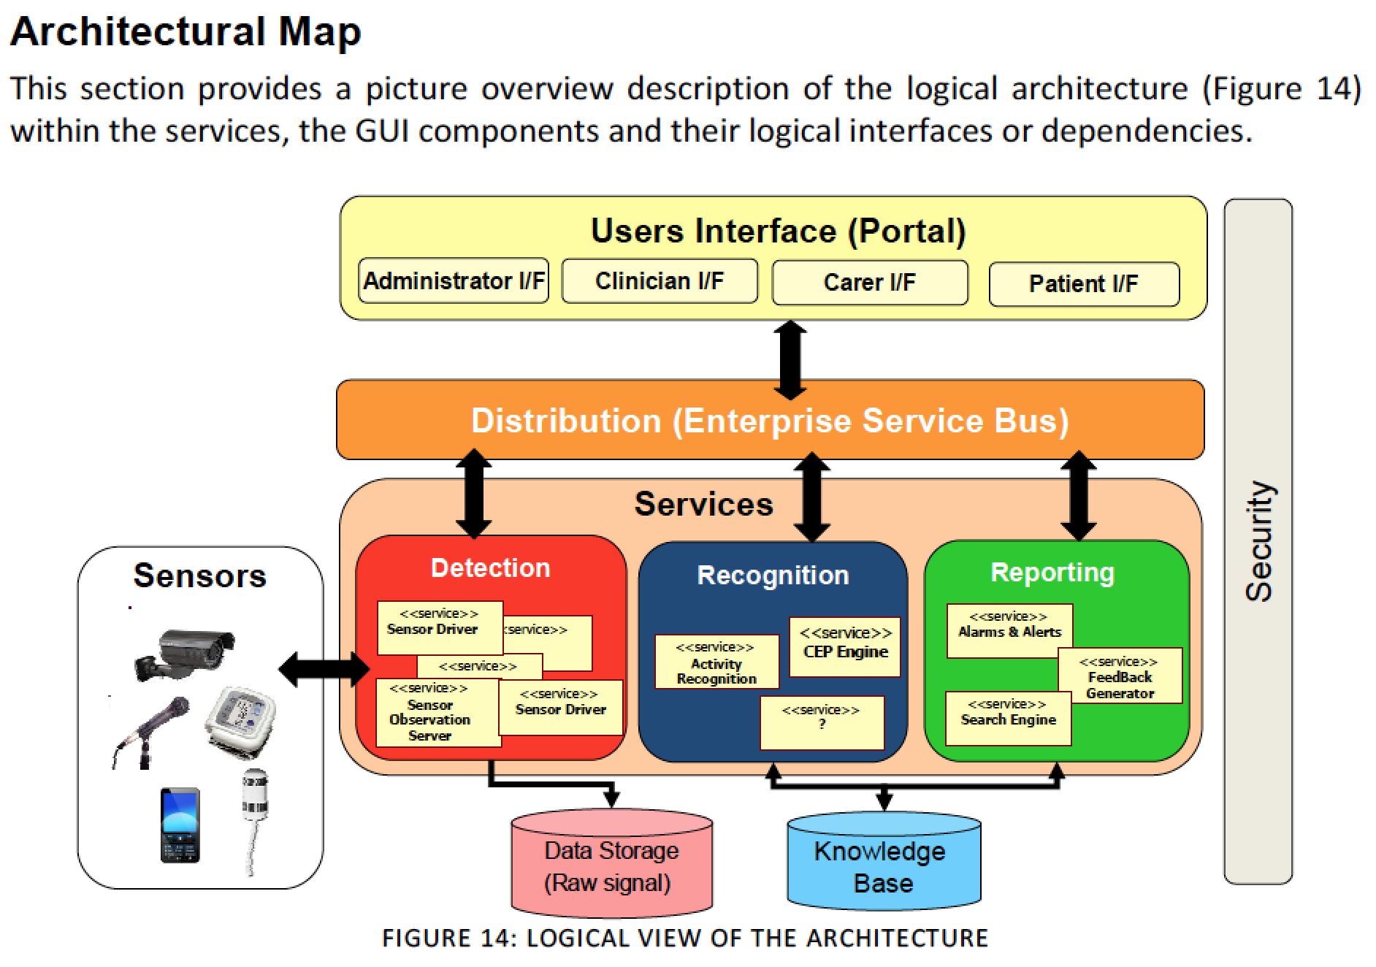

Slide 20
Component and connector views
Process: units are processes, connected by communication or synchronization
Concurrency: to determine opportunities for parallelism (connector = logical thread)
Shared data: shows how data is produced and consumed
Client-server: cooperating clients and servers

Slide 21
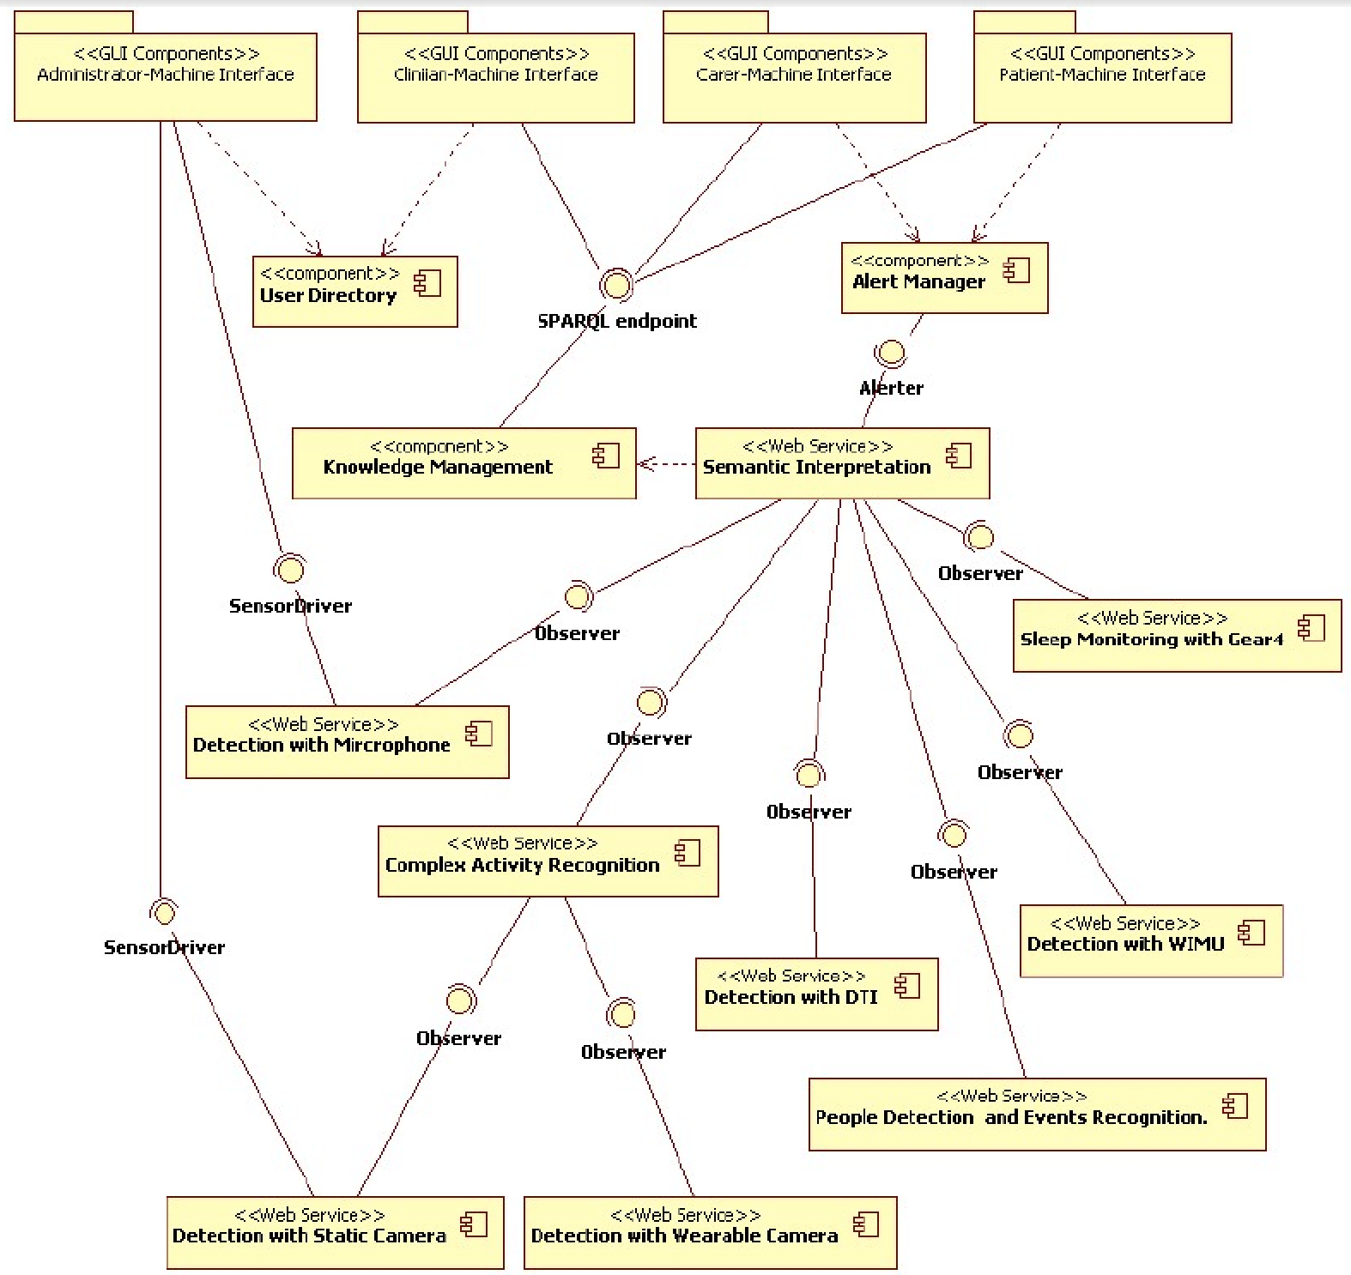
Notes:
Why is it not complete? They are still trying to give an overarching picture of it rather than focusing on specific parts… when software becomes too big it is difficult to visualize…

Slide 22
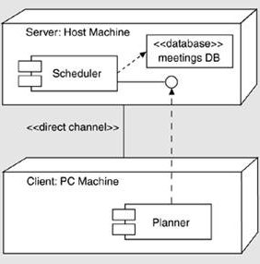
Allocation views
Deployment: how software is assigned to hardware elements
Implementation: how software is mapped onto file structures
Work assignment: who is doing what
Notes:
Deployment: elements: software (meestal process van C&C view), hardware elements and communication pathways. Geeft aan waar software zit, en hoe het evt migreert. Dan kun je redeneren over performance, security, availability, ed.
Implementation: voor management van ontwikkelactiviteiten, build processes.
Work assignment: welke kennis heb je waar nodig?, functional commonality aan 1 team toewijzen, etc.

Slide 23
How to decide on which viewpoints
What are the stakeholders and their concerns?
Which viewpoints address these concerns?
Prioritize and possibly combine viewpoints

Slide 24
The typical Architectural view - which may not be so good for development

Slide 25
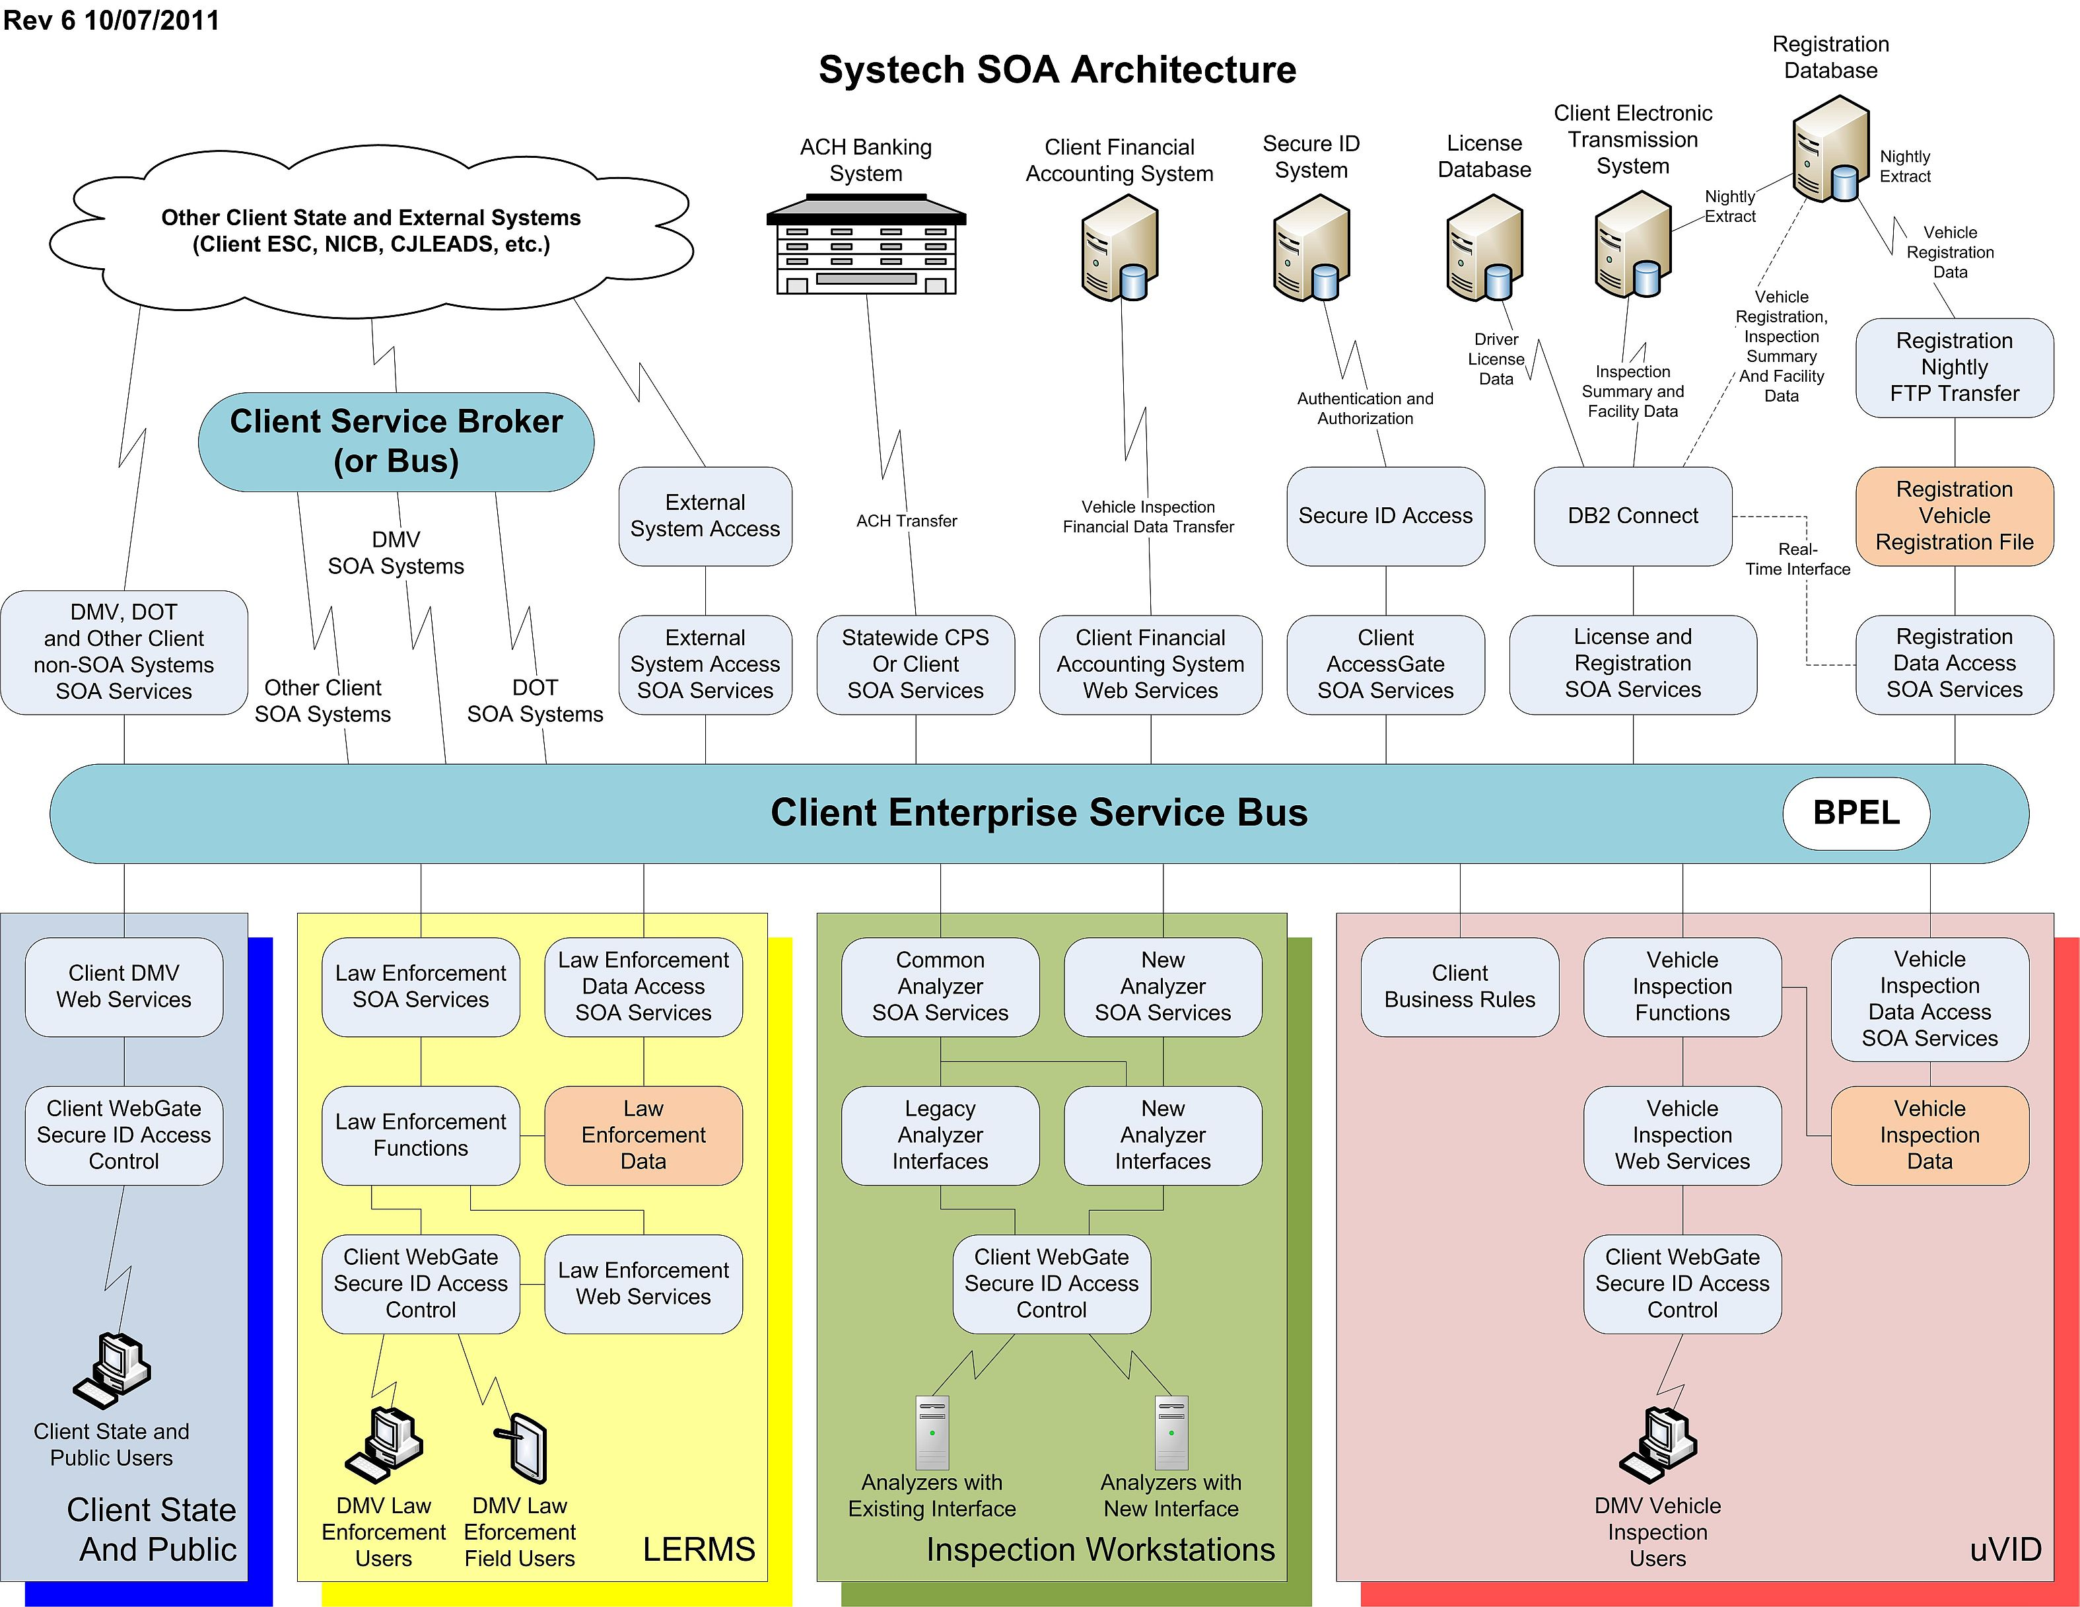

Slide 27
For whom is that architecture for? Will it stay updated?

Slide 28
Notes:
Why is it not complete? They are still trying to give an overarching picture of it rather than focusing on specific parts… when software becomes too big it is difficult to visualize…

Slide 29
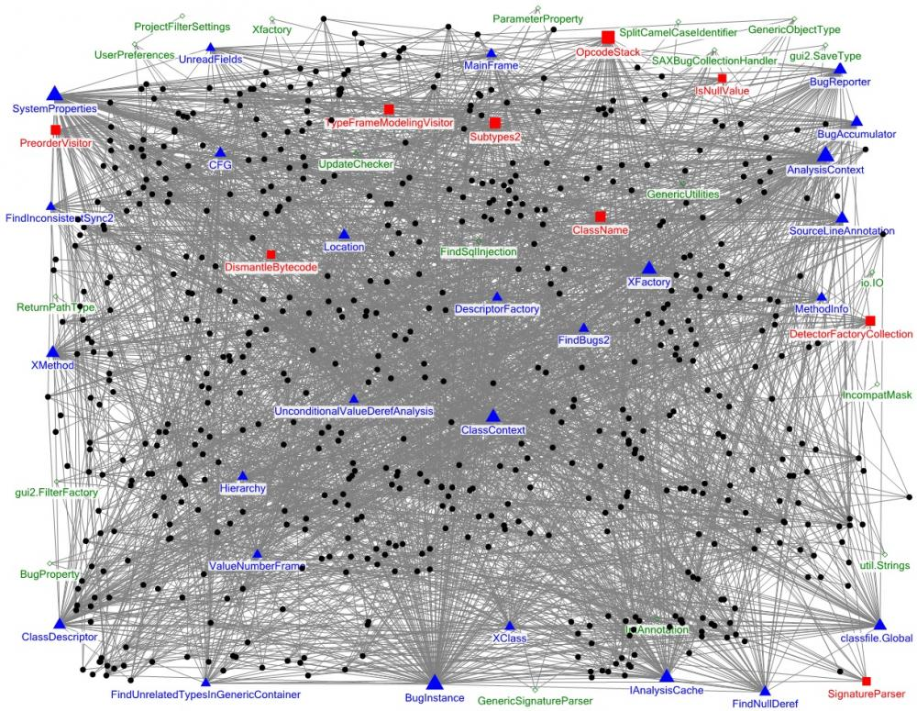

Slide 30
5 minute break
https://www.youtube.com/watch?v=ocwnns57cYQ

Slide 31
But back to addressing the problems
What purpose does the architecture serve?
How do we make sure it is maintained?
How do we visualize/communicate it?

Slide 32
The core of software architecture
Software architecture is about dependency management
“Architecture exists to define dependency flow and to create strategic pockets of isolation, both to minimize the impact of necessary changes and to help with organization and division of labor.”

Slide 33
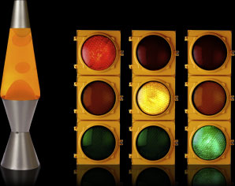
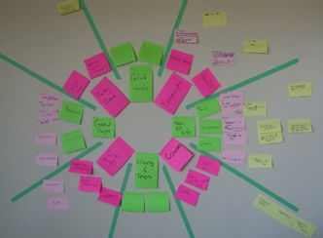
Information radiator
Making sure each delivery is true to the architecture

Slide 34
Discussion: But how do you visualize/communicate the design?
How do you analyze design?
What do you look for to
Understand structure and dependencies?
Understand how the software works and runs?
Understand what features it has?
Understand where to add code?

Slide 35
How to identify design IMHO
Two alternatives
Top down (Overall→Modules→Classes→Code)
Follow the execution path
What launches the application
What happens next?
Pick a specific operation (use-case) and follow the execution path for that operation (e.g. logging in or load a document)

Slide 36
GitHub example
https://github.com/cgeo/cgeo

Slide 37
Architecture Reconstruction Process
Raw view extraction
Source code, execution traces, build scripts, etc.
Database construction
View fusion and manipulation
Observe data relationships etc. from database
Create a fused view to illustrate how data fit together
Architecture analysis
Conformance

Slide 38
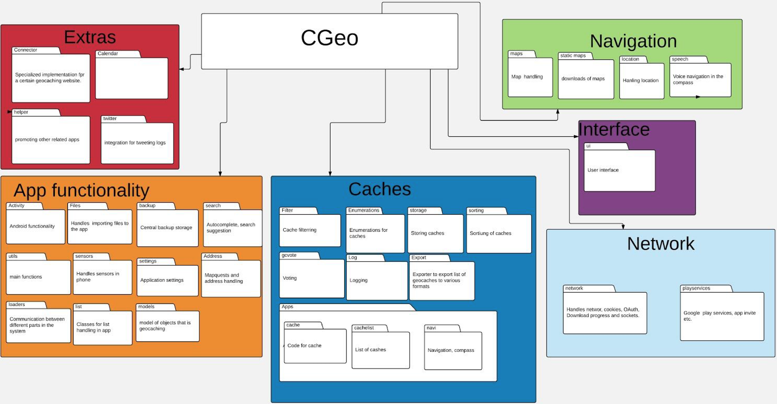
High level design
Credit: Emil Vidmark & Viktor Fällman

Slide 39
Layered Module Diagram
C:GEO High Level Design
Interface
Caches
App functionality
Extras
Navigation
Network

Slide 41
Visualization

Slide 42
Evaluating Visualizations
Scope and Purpose
What is the visualization for?
What can it visualize?
Depiction
Interaction
Stakeholder interests

Slide 43
Evaluating Visualizations (cont’d)
Fidelity
How well/completely does the visualization reflect the information in the underlying model?
Consistency
How well does the visualization use similar representations for similar concepts?
Comprehensibility
How easy is it for stakeholders to understand and use a visualization

Slide 44
Evaluating Visualizations (cont’d)
Dynamism
How well does the visualization support models that change over time (dynamic models)?
View Coordination
How well the visualization is connected to and kept consistent with other visualizations
Aesthetics
How pleasing is the visualization (look and feel) to its users?
A very subjective judgment
Extensibility
How easy is it to add new capabilities to a visualization?

Slide 45
New Visualizations: Guidelines
Borrow elements from similar visualizations
Leverages existing stakeholder knowledge
Improves comprehensibility
Be consistent among visualizations
Don’t conflict with existing visualizations without a good reason (e.g., developing a domain-specific visualization where the concepts and metaphors are completely different)
Give meaning to each visual aspect of elements

Slide 46
New Visualizations: Guidelines (cont’d)
Document the meaning of visualizations
Visualizations are rarely self-explanatory
Focus on mapping between model and visualization
Balance traditional and innovative interfaces
Stakeholders bring a lot of interaction experience to the table
But just because a mechanism is popular doesn’t mean it’s ideal

Slide 47
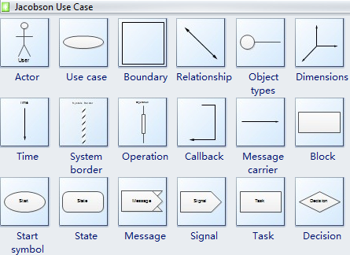
Common symbols

Slide 48
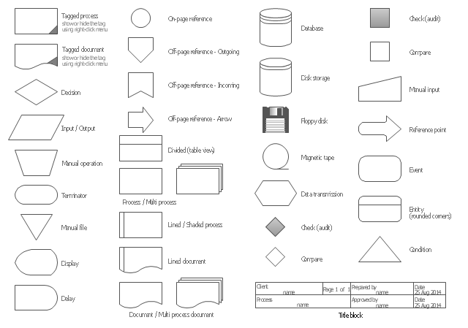

Slide 49
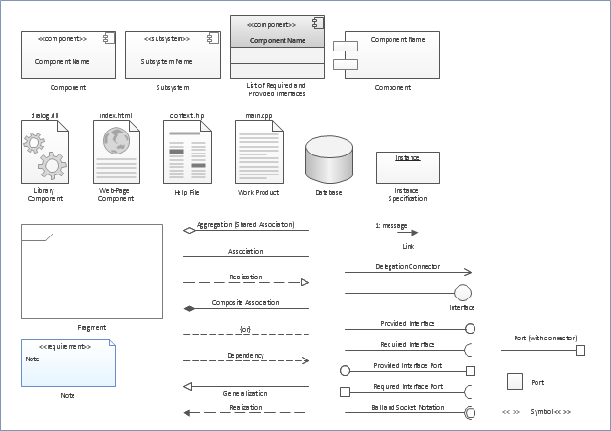

Slide 50
New Visualizations: Anti-Guidelines
Same Symbol, Different Meaning
Software Architecture: Foundations, Theory, and Practice; Richard N. Taylor, Nenad Medvidovic, and Eric M. Dashofy; (C) 2008 John Wiley & Sons, Inc. Reprinted with permission.

Slide 51
New Visualizations: Anti-Guidelines (cont’d)
Differences without meaning
Software Architecture: Foundations, Theory, and Practice; Richard N. Taylor, Nenad Medvidovic, and Eric M. Dashofy; (C) 2008 John Wiley & Sons, Inc. Reprinted with permission.

Slide 52
New Visualizations: Anti-Guidelines (cont’d)
Decorations without meaning
Software Architecture: Foundations, Theory, and Practice; Richard N. Taylor, Nenad Medvidovic, and Eric M. Dashofy; (C) 2008 John Wiley & Sons, Inc. Reprinted with permission.

Slide 53
New Visualizations: Anti-Guidelines (cont’d)
Borrowed symbol, different meaning
Software Architecture: Foundations, Theory, and Practice; Richard N. Taylor, Nenad Medvidovic, and Eric M. Dashofy; (C) 2008 John Wiley & Sons, Inc. Reprinted with permission.

Slide 54
Constructing New Visualizations
Must answer many questions in advance
Can I achieve my goals by extending an existing visualization?
Can I translate into another notation and use a visualization already available there?
How will my visualization augment the existing set of visualizations for this notation?
How will my visualization coordinate with other visualizations?

Slide 55
Summary
Manage dependencies
Reduce communication bottlenecks
Maintain/enforce the architecture
Choose the right visualization
Shareability
Contributability
Flexibility
Expressability

